Slide 1
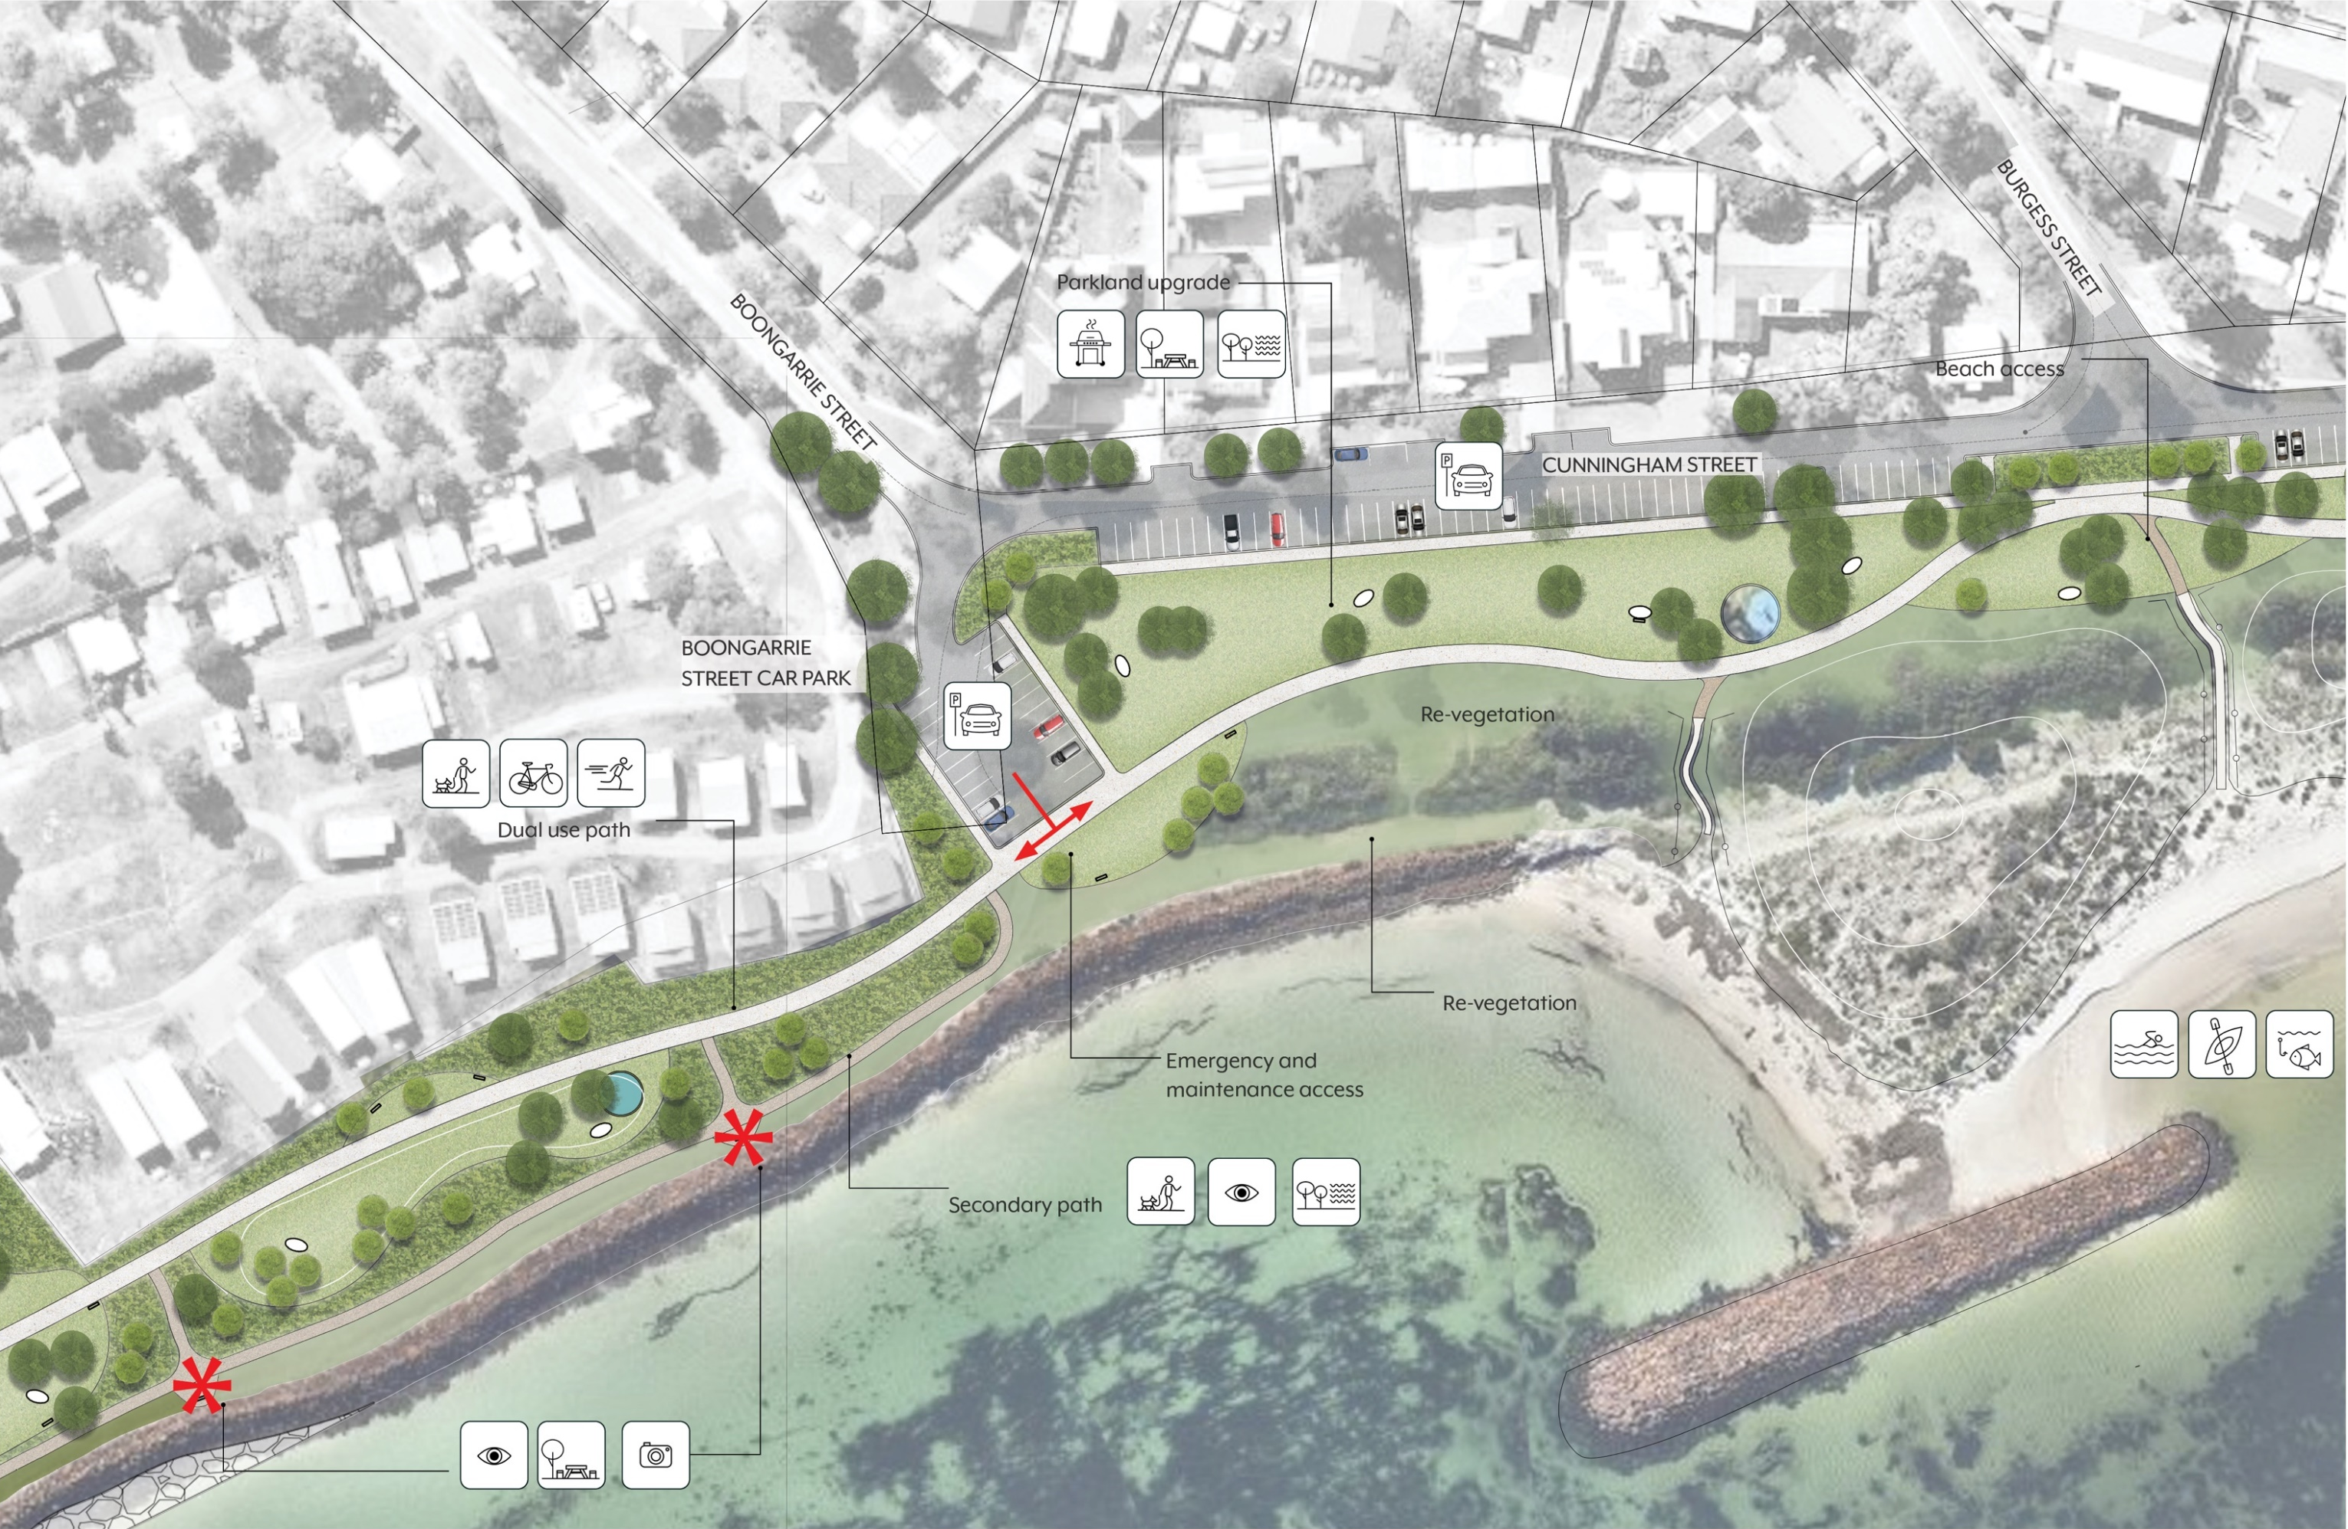
Landscape Masterplan
Boongarrie street
Foreshore Management Plan
Emu Point Beach and Emu Point
Emu Beach
Foreshore Management Plan

Slide 2
Landscape Masterplan
Typical sections
Foreshore Management Plan
Emu Point Beach and Emu Point
Emu Beach
Foreshore Management Plan

Slide 3
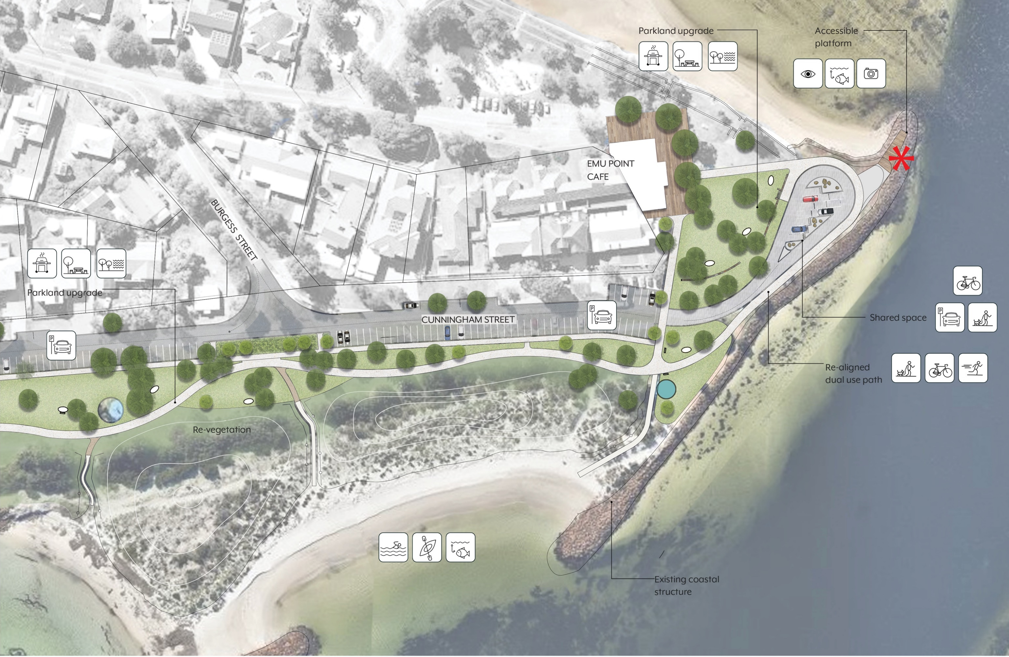
Landscape Masterplan
Emu Point
Foreshore Management Plan
Emu Point Beach and Emu Point
Emu Beach
Foreshore Management Plan

Slide 4
Landscape Masterplan
Typical sections
Foreshore Management Plan
Emu Point Beach and Emu Point
Emu Beach
Foreshore Management Plan

Slide 5
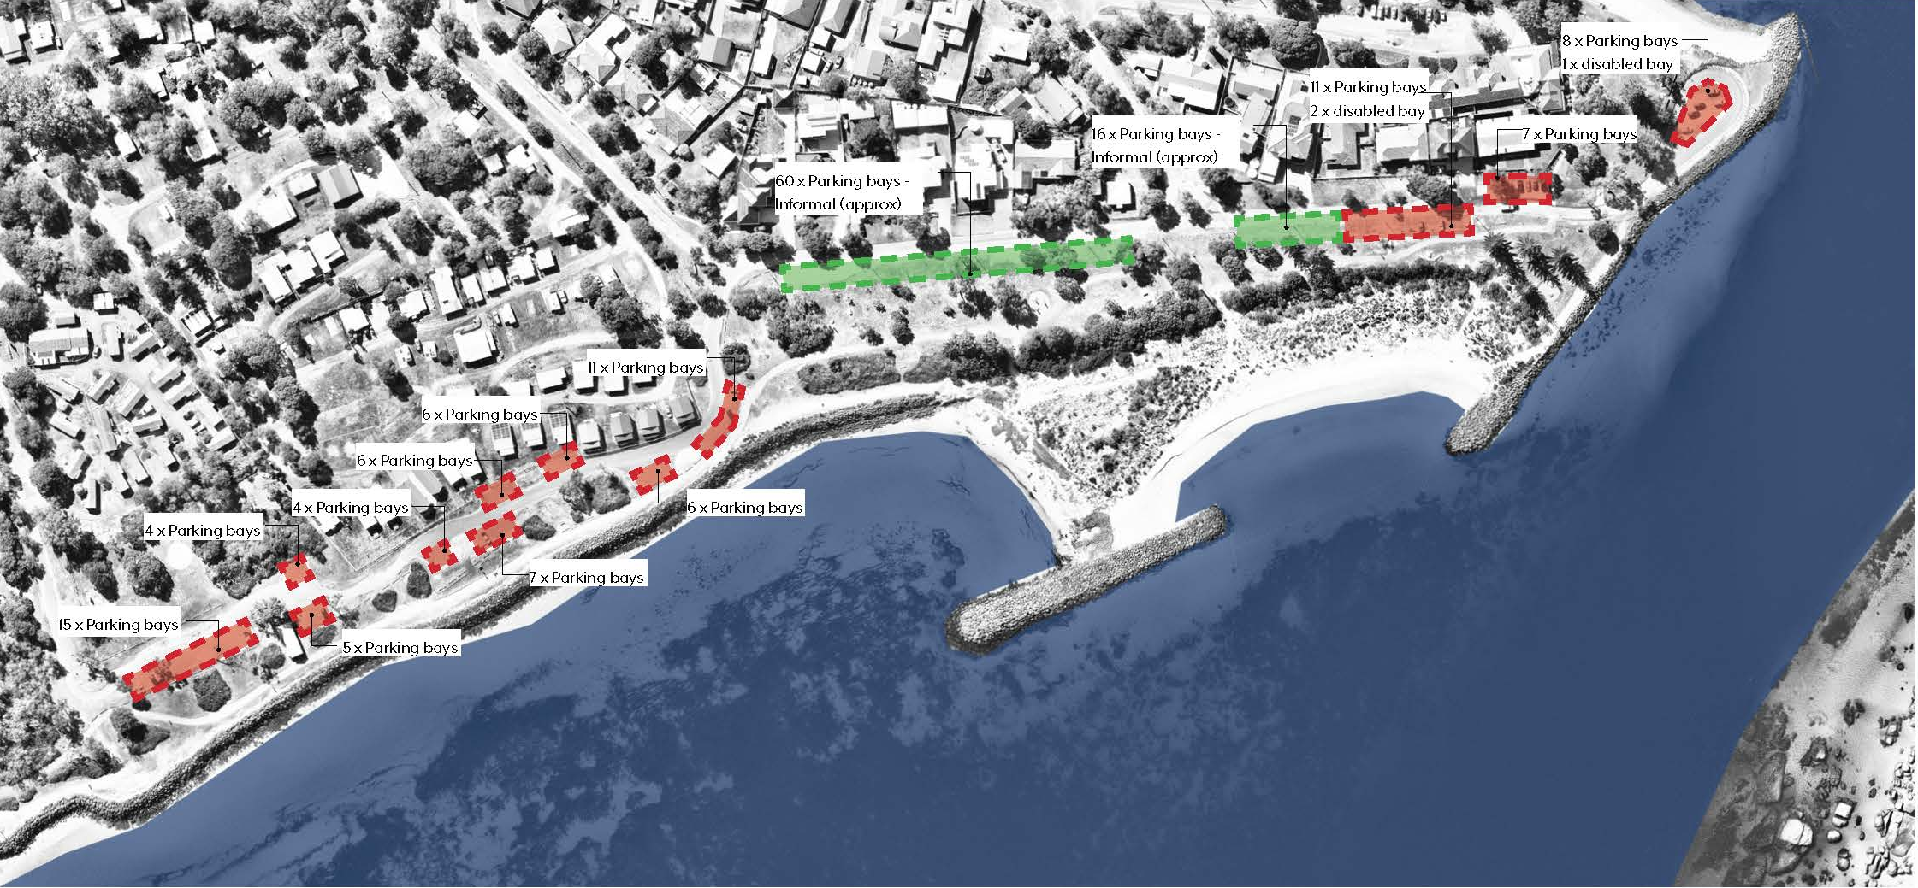
Existing Parking
Landscape Masterplan
Existing parking numbers and locations along
Emu Beach:
Formal parking bays 93
Informal parking bays 76 (approx.)
TOTAL 169
In peak periods vehicles are often located on informal verge treatments with limited formal path access including minimal disabled access
Foreshore Management Plan
Emu Point Beach and Emu Point
Emu Beach
Foreshore Management Plan

Slide 6
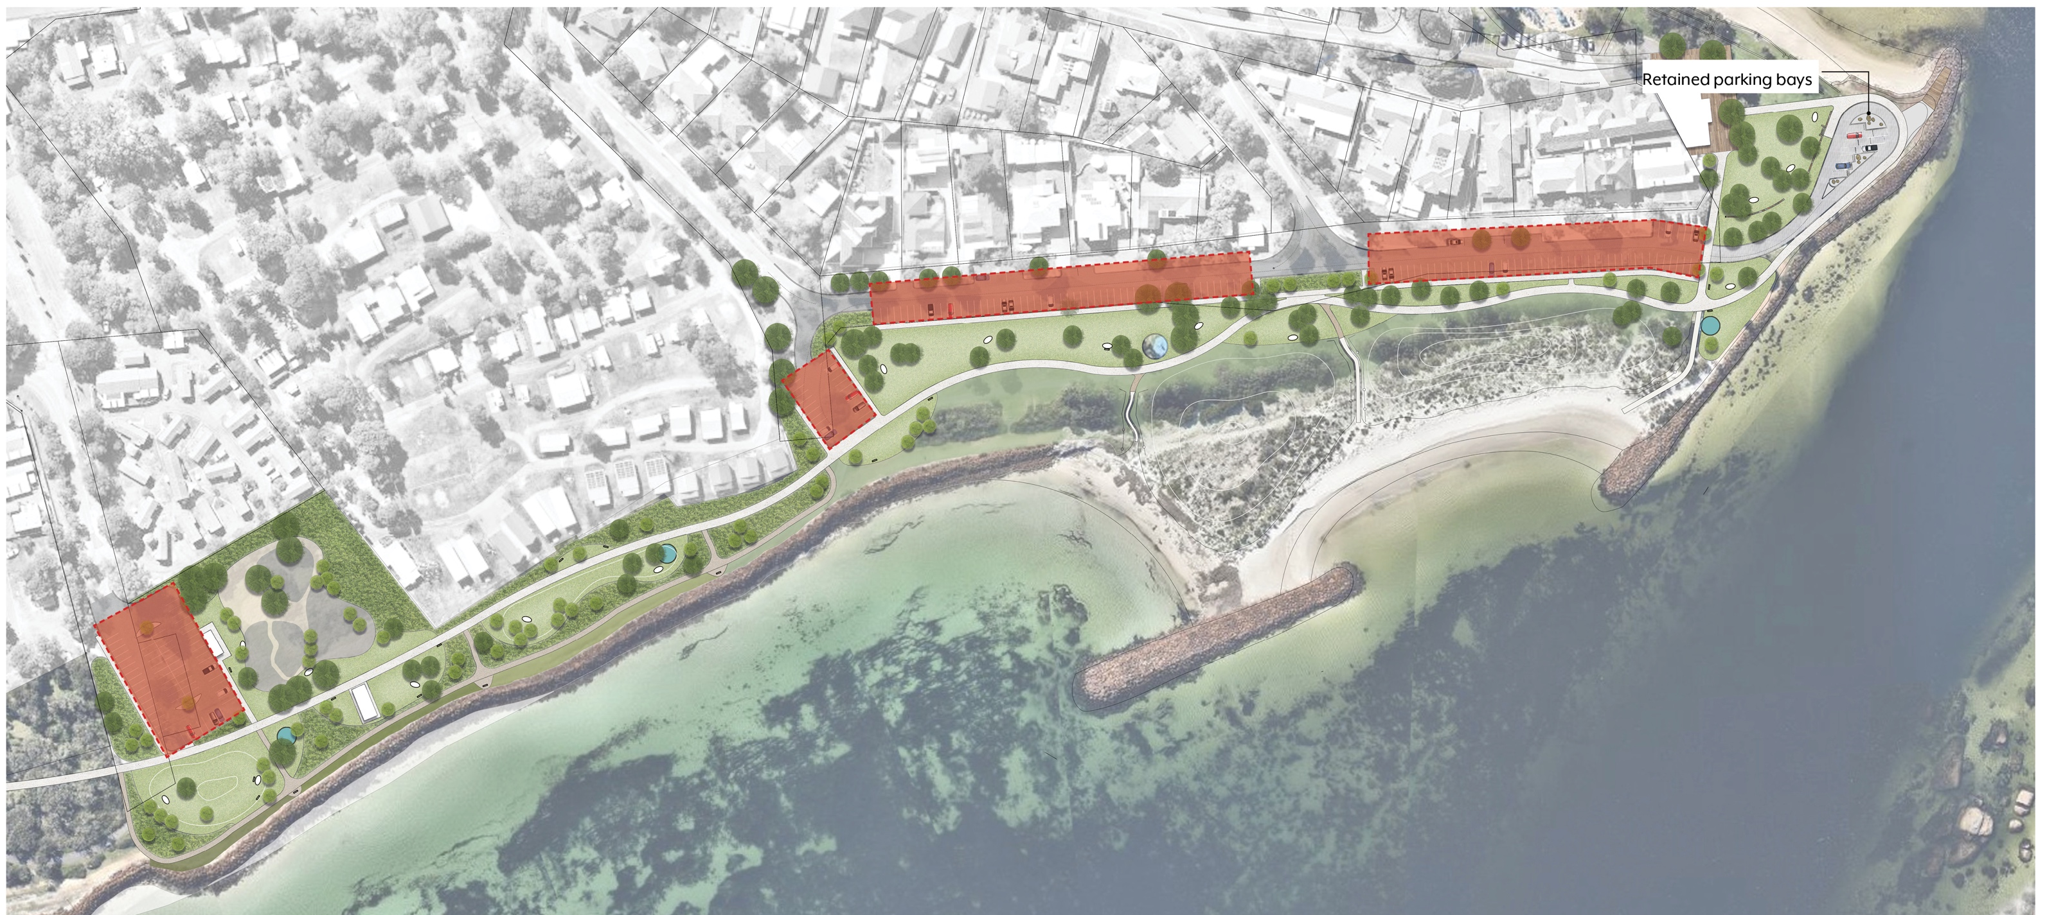
Proposed parking
Landscape Masterplan
Proposed parking numbers and locations along
Emu Beach:
Formal parking bays 210
Retained existing bays 9
TOTAL 219
Foreshore Management Plan
Emu Point Beach and Emu Point
Emu Beach
Foreshore Management Plan

Slide 7
Finishes, furniture + fixtures
Landscape Palette
Emu Beach material palette will require selections to offer the following; robustness, long term sustainability and create a sense of place
The extreme coastal conditions will require materials to be resilient and tough. Constant salt winds and moisture along with frequent public use will require materials to be hard wearing whilst reducing overall maintenance requirements for the City
A palette with a strong sense of place will play an important role in ensuring Emu Beach maintains it uniqueness while creating a memorable experience
Foreshore Management Plan
Emu Point Beach and Emu Point
Emu Beach
Foreshore Management Plan

Slide 8
Coastal Planting
Landscape Palette
Emu Beach foreshore, parkland and street scape has the opportunity to utilise both local and West Australian coastal species. Many of the species are available commercially allowing planting to enhance the local material palette whilst ensuring low water use and maintenance
Low level planting is nominated to maintain site lines in key open public spaces with the inclusion of larger coastal shrubs to offer protection and buffer the strong prevailing coastal winds
Native trees to be selected to offer shade along the parkland whilst ensuring the species are adaptable in the harsh coastal conditions
Rehabilitation and re-vegetation of the emu beach foreshore is critical to ensure the future of the key wildlife corridor increasing biodiversity whilst improving user experience
Foreshore Management Plan
Emu Point Beach and Emu Point
Emu Beach
Foreshore Management Plan

Slide 9
Play space
Landscape Destination
A destinational play space creates the opportunity to bring together both the local community and visitors to the region.
The inclusion of various play options ensures that all members of the community are catered for. With the opportunity to include intergenerational play elements with a range of activities including; multi use courts, nature based play, pump track and an all ages/ inclusive and accessible playground
Pump track - a multi use track for all ages offering locals and visitors year round entertainment and exercise
Nature play - responding to the surrounding natural coastal environment and encouraging children of all ages to explore and interact with ‘nature’
All ages/inclusive and accessible - a play space designed to cater for all ages and disabilities. With the added benefit of proximity to both parking and ablution facilitates
Multi-use courts - various courts offering individual and group exercise opportunities for both local and visitors to the region staying within the Emu Beach accommodation zone
Foreshore Management Plan
Emu Point Beach and Emu Point
Emu Beach
Foreshore Management Plan

