Slide 1
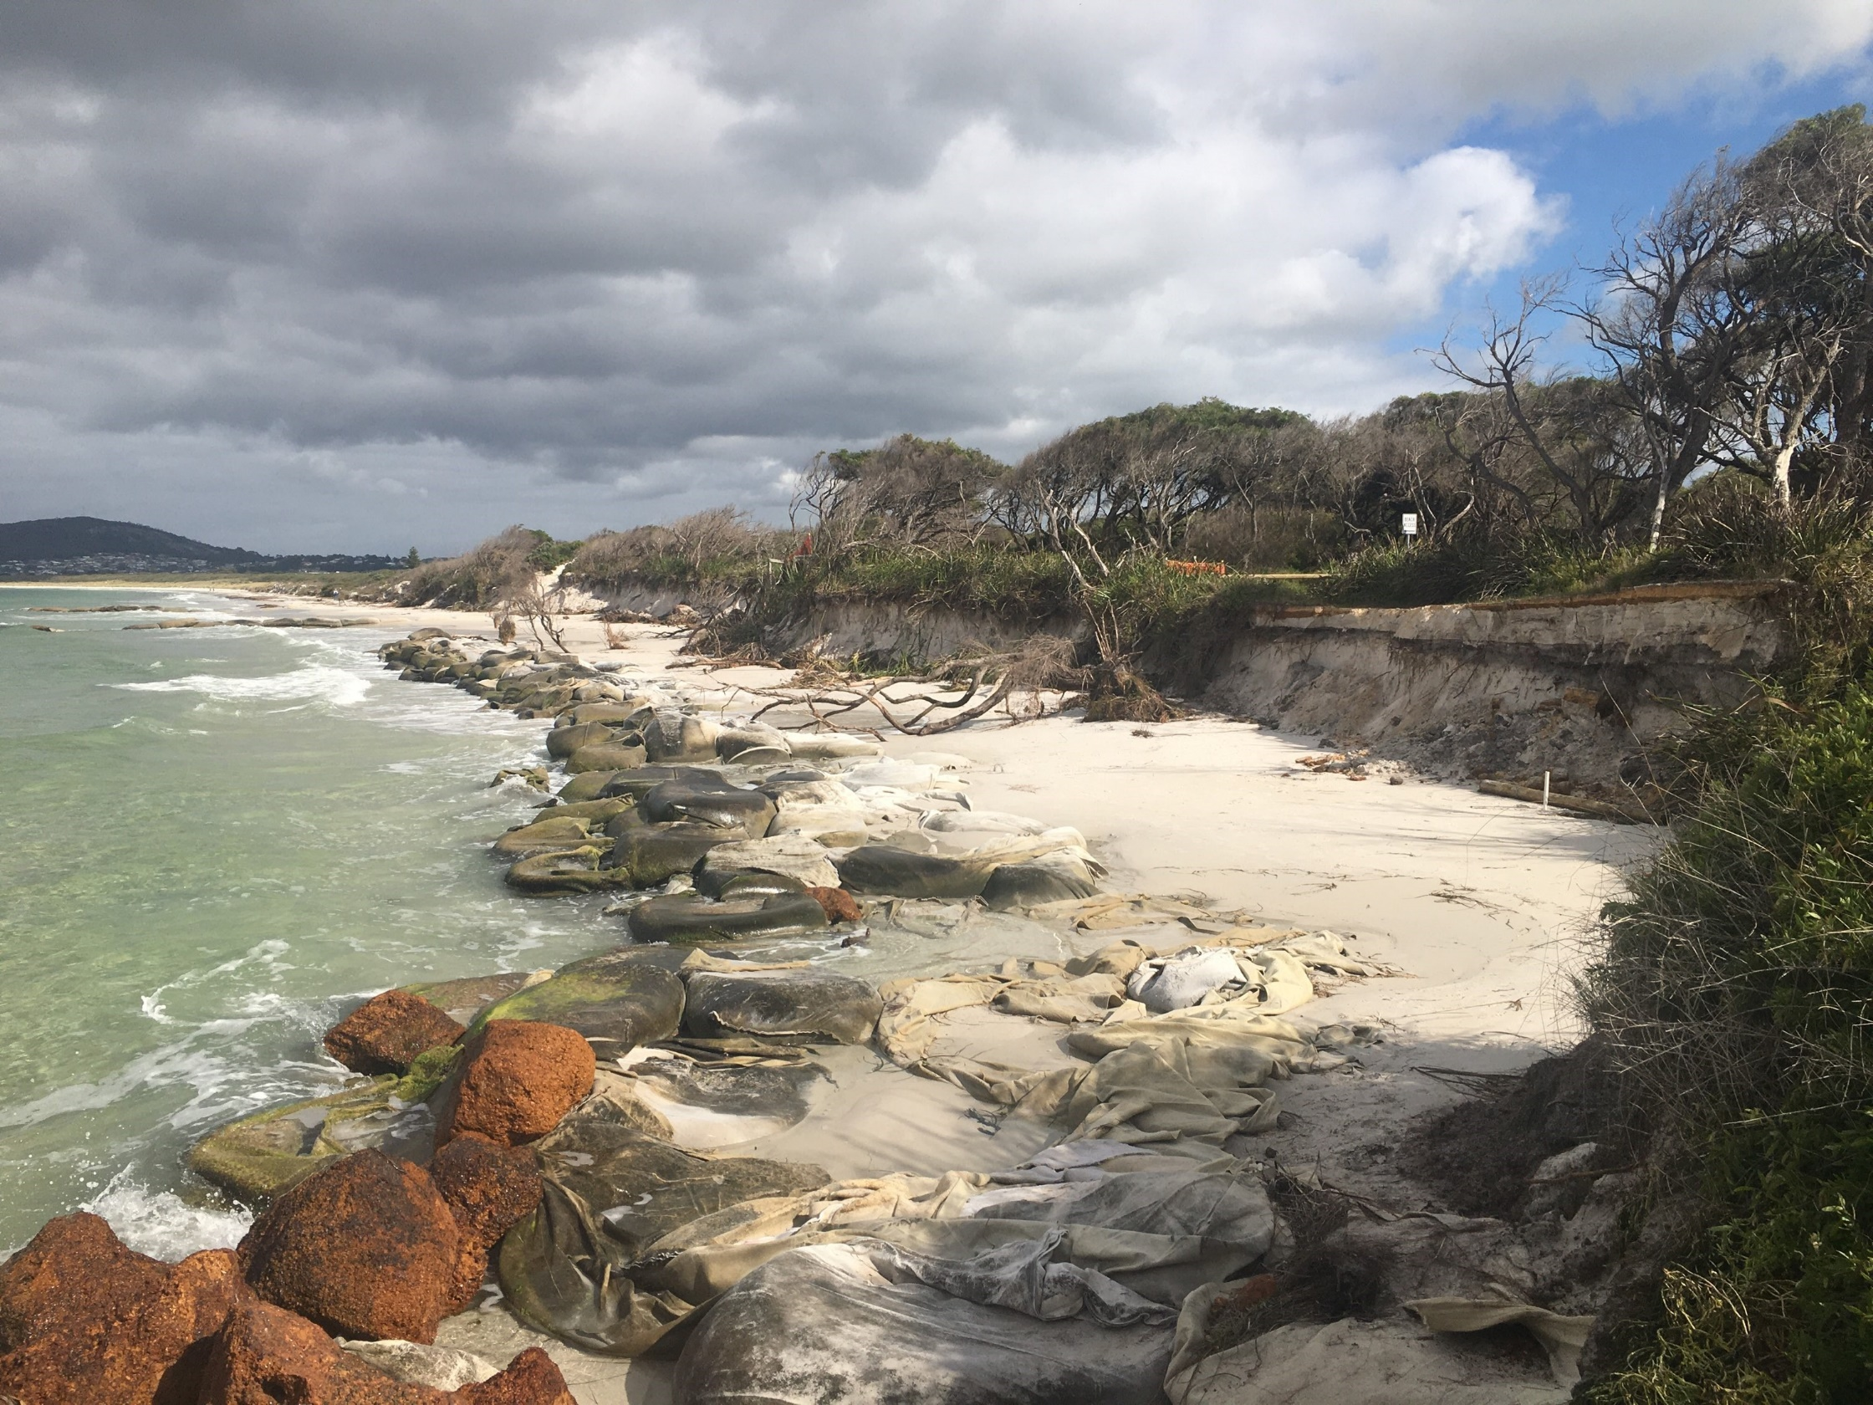
FMP Implementation – Short term actions
Next 0-10 years
Implement sand nourishment in the eastern corner of the Oyster Harbour Beach, when there is less than 5 m between the HSD and the northern groyne
Identify the coastal vulnerability of the FMP area in the CoA’s strategic planning framework
Undertake a planning scheme amendment to include the vulnerable zone (the modelled hazard area to 2120) in a Special Control Area
Agree on updated lease arrangement for the southern portion of the park with Emu Beach ‘BIG4’ Holiday Park
Seek State and Federal funds to undertake the capital works for the Landscape Master Plan and granite boulder groyne field establishment
Commence Emu Beach sand nourishment
Emu Beach
Foreshore Management Plan

Slide 2
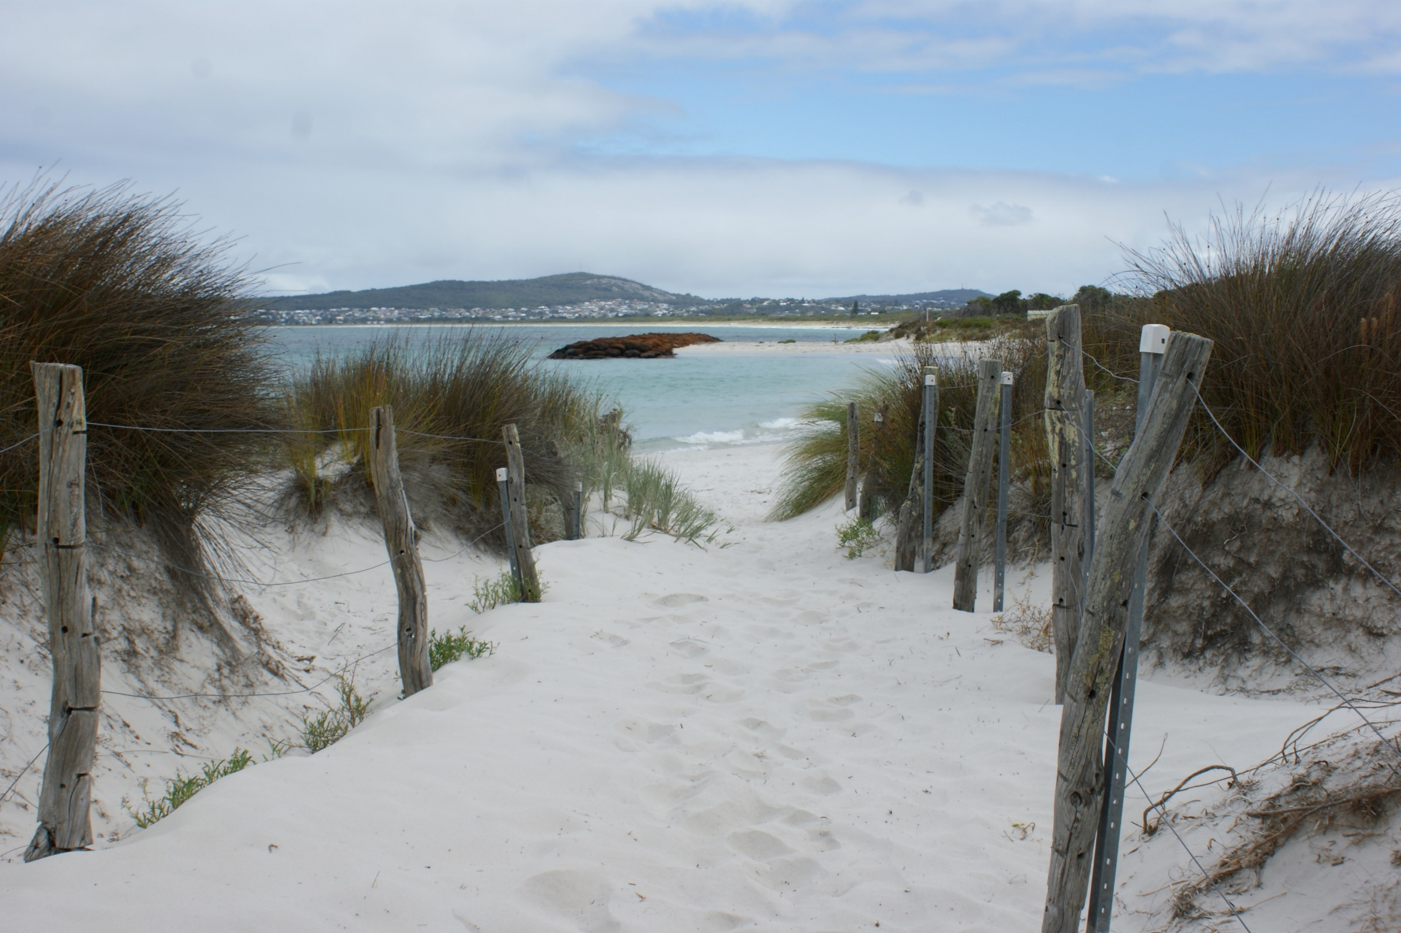
FMP Implementation – Medium term actions
Next 10-50 years
Investigate the opportunity to acquire at risk land as it becomes available on the public market, when the HSD is less than 40 m from Griffiths Street
Seek State and Federal funds to undertake the capital works for the upgrades to the existing coastal protection structures when:
any section of rock revetment is assessed to be in “Very Poor” condition; or
more than three overtopping events of a rock revetment structure are recorded within a 12-month period.
Emu Beach
Foreshore Management Plan

